Slide 1
KSC 6103 Data Structure & algorithm analysis
ARRAY REVISION

Slide 2


LEARNING OUTCOME
 | Understand the concept of Array.
 | Differentiate the operations of Array.

Slide 3
CHAPTER CONTENT
Chapter 3: Array
3.1 Overview of Array Data Structure
3.2 Array Operations
3.2.1 Example of Insertion and Deletion Operations
3.2.2 Example of Sorting Operations
3.3 Types of Array

Slide 4
Overview of array data structure

Slide 5
Arrays
Array is basically a data structure which can hold more than one value at a time.
It is a collection or ordered series of items at same time
Each item stored in an array is called an element
Each location of an element in an array has a numerical index, which is used to identify the element
Format: array_name = array(‘type_code’,[initializer])

Slide 6
Type Code
Type Code | Value
b | Represents signed integer of size 1 byte
B | Represents unsigned integer of size 1 byte
c | Represents character of size 1 byte
i | Represent signed integer of size 2 bytes
I | Represents unsigned integer of size 2 byte
f | Represents floating point of size 4 bytes
d | Represents floating point of size * bytes

Slide 7
How to Create an Arrays in Python
Arrays in Python can be created after importing the array module
There are three methods to import array library
import array
import array as arr
From array import *

Slide 8
Accessing Array Element
Accessing elements using index value
Index starts from 0 to n-1 where n is the number of elements
-ive index value can be used as well, -ive indexing start from reverse order
0 | 1 | 2 | 3 | 4 | 5

Slide 9
Example
import array as arr
a=arr.array(‘i’, [2,4,6,8])
print(“First element: ”, a[0])
print(“Second element: ”, a[1])
print(“last element: ”, a[-1])
Output
First element: 2
Second element: 4
Last element: 8

Slide 10
Array operation

Slide 11
Basic Array Operation
Finding the length of an array
Adding/Changing element of an array
Removing/deleting element of an array
Array concatenation
Slicing
Looping through an array
sorting

Slide 12
Finding the length of an array
Number of element present in the array
Using len() function to find the length
The len() function returns an integer value that is equal to the number of elements present in that array

Slide 13
Finding the length of an array
Syntax
len(array_name)
Example
from array import *
a = array(‘i’,[2,4,6,8])
print(len(a)) Output : 4

Slide 14
Adding elements to an array
Using functions to add elements
append() is used to add a single element at the end of an array
extend() is used to add a more than one element at the end of an array
Insert() is used to add an element at the specific position in an array

Slide 15
Example
from array import *
numbers = array(‘i’,[1,2,3])
numbers.append(4)
print(numbers)
numbers.extend([5,6,7])
print(numbers)
numbers.insert(3,8)
print(numbers)
Output
array(‘i’, [1,2,3,4])
array(‘i’, [1,2,3,4,5,6,7])
array(‘i’, [1,2,3,8,4,5,6,7])

Slide 16
Removing elements of an array
Functions used to removing elements of an array
pop() is used when we want to remove an element and return it.
remove() is used when we want to remove an element with a specific value without returning it

Slide 17
Example
import array as arr
numbers = arr.array(‘i’,[10,11,12,12,13])
numbers.remove(12)
print(numbers) #output: array(‘i’, [10,11,12,13])
numbers.pop(2) #output: 12
print(numbers)

Slide 18
Array Concatenation
Array concatenation is done using + sign
Example
import array as n
a = n.array(‘i’, [10,11,12,12,13])
b = n.array(‘i’, [21,22,35,26,39])
c = a+b
print(c)
#output: array(‘i’, [10,11,12,12,13,21,22,35,26,39])

Slide 19
Slicing an array
An array can be sliced using the :symbol
This returns a range of elements that we have specified by the index number
Example
import array as arr
number_list = [2,5,62,5,42,52,48,5]
print(number_array[2:5]) #2rd to 4th
print(number_array[:-5]) #beginning to 2th
print(number_array[5:]) #5th to end
print(number_array[:]) #beginning to end

Slide 20
Looping through an array
For loop used to iterates over the items of an array specified number of times
While loop iterates the elements until a certain condition is met
Example
from array import *
number_list = [2,5,62,5,42,52,48,]
a = array(‘i’, numbers_list)
for x in a:
print(x)

Slide 21
Sorting of an array
Sort the elements of the array in ascending order
Use sorted() built in function to sort the array
Format: sorted(array_name)

Slide 22
Example
from array import *
a = array(‘i’, [4,3,6,2,1])
b = sorted(a)
for x in b:
print(x)
Output:
1
2
3
4
5
6

Slide 23
Sorting of array in descending order
Format: sorted(array_name, reverse=true)
Example:
from array import *
a = array(‘i’,[4,3,6,2,1])
b = sorted(a, reverse=true)
for x in b:
print(x)
Output:
6
5
4
3
2
1

Slide 24
Summary of Array Methods
Python has a set of built-in methods that you can use on lists/arrays
Method | Description
append() | Adds on element at the end of the list
clear() | Removes all the elements from the list
copy() | Returns a copy of the list
count() | Returns the number of elements with the specified value
extend() | Add the elements of a list (or any iterable), to the end of current list
index() | Returns the index of the first element with the specified value
insert() | Adds an element at the specified position
pop() | Removes the element at the specified position
remove() | Removes the first item with the specified value
reverse() | Reverses the order of the list
sort() | Sorts the list

Slide 25
Types of arrays

Slide 26
Types of Arrays
As we know that arrays are of 3 types which include
1D Array
2D Array
Multi D Array
In python there are one package call numpy used to organize array

Slide 27
Import numpy
There are three methods to import numpy
import numpy
import numpy as np
from numpy import *

Slide 28
Example of 1 D Array
import numpy as np
a = np.array([10,20,30,40,50])
print(a)
Output
array([10,20,30,40,50])

Slide 29
Example of 2D Array
#3x3 array
import numpy as np
a = np.array([10,20,30],
[40,50,60],
[70,80,90])
print(b)

Slide 30
Example of 3D Array
#3x3x3 array
import numpy as np
c = np.array([[1,2,3],[4,5,6],[7,8,9]],
[[9,8,7],[6,5,4],[3,2,1]],
[[1,2,3],[4,5,6],[7,8,9]])
print(c)

Slide 31
Example of Array-Based Sequences (Application)
Storing High scores for game
Sorting a sequence
Simple Cryptography

Slide 32
Storing high scores for game
The objective is to store high score entries for a video game.
Each game entry has a name and a score. Corresponding class is GameEntry.
To maintain a sequence of high scores, we create another class called Scoreboard.
Scoreboard can have limited number of entries. A new score only qualifies for the scoreboard if it is strictly higher than the lowest of the high scores in the board.
When a new entry is made to the scoreboard, elements are shifted to the right to create an appropriate space for new score.

Slide 33
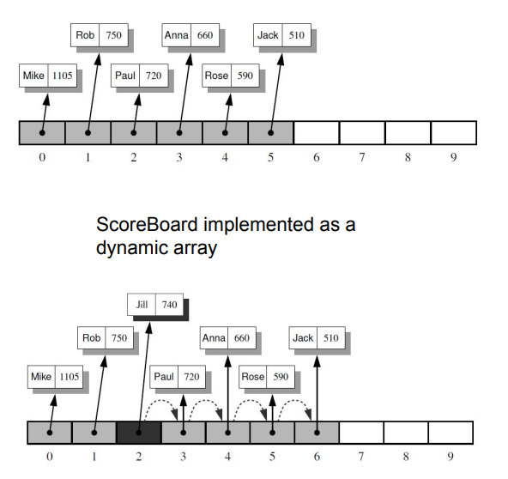

Slide 34
# gameentry class
Class GameEntry:
def _init_(self, name,score)
self._name = name
self._score = score
def get_name(self):
return self._name
def get_score(self):
return self._score
def _str_(self):
return ‘({0},{1})’.format(self._name,self._score)

Slide 35
#scoreboard class
Class Scoreboard:
def _init_(self, capacity=10):
self._board = [None]*capacity
self._n = 0
def _getitem_(self,k):
return self._board[k]
def _str_(self):
return ‘\n’.join(str(self._board[j]) for j in range(self._n))
def add(self,entry):
score = entry.get_score()
good = self._n < len(self._board) or score > self._board[-1].get_score()
if good:
if self._n < len (self._board):
self._n += 1
j = self._n – 1
while j > 0 and self._board[j-1]
self._board[j] = self._board[j-1]
j -= 1
self._board[j] = entry

Slide 36
#main
S = Scoreboard()
S.add(GameEntry(‘Mike’,1105))
S.add(GameEntry(‘Rob’,750))
S.add(GameEntry(‘Paul’,720))
S.add(GameEntry(‘Anna’,660))
S.add(GameEntry(‘Rose’,590))
S.add(GameEntry(‘Jack’,510))
print(‘Entries of scoreboard:\n’, S)
S.add(GameEntry(‘Jill’,510))
print(‘Entries of scoreboard:\n’, S)

